Slide 1
Coaching Collaboration
Kirsten Butcher
Head Core Values Judge, Utah FLL
University of Utah
Dept. of Educational Psychology
August 3, 2012

Slide 2
Coaches: Core Values Worry
“I hear there is a core values activity during judging. How do I prepare my team to complete the core values activity??!”

Slide 3
“We are a team”
Collaboration doesn’t happen naturally – requires hard work and continuous effort!
Every person’s individual knowledge, ideas, and experiences makes the team stronger
BUT … teams are more than collection of individuals

Slide 4
Gracious Professionalism
Inclusion: Consideration and appreciation for the contributions (ideas and skills) of all team members, with balanced involvement
Respect: Team members act and speak with integrity so others feel valued – especially when solving problems or resolving conflicts

Slide 5
Teamwork
Effectiveness: Problem solving and decision making processes help the team achieve their goals
Kids Do the Work: Appropriate balance between team responsibility and coach guidance

Slide 6
Surprise! Instant Teams!
Ideally, 3-5 people on a team

Slide 7
Team Logo
Using any coins, objects, accessories that you have in your pockets/bags, create a logo that represents you as a team.
2 minutes
Activity Modified From:
http://blog.huddle.net/building-teamwork-10-quick-and-easy-team-building-exercises-for-improving-communication-and-problem-solving-skills-part-1

Slide 8
Reflection
Did everyone contribute equally?
Did you hear everyone’s ideas?
Did you understand everyone’s ideas?
Did anyone ask you questions?
Did you ask anyone else questions?
Did you provide constructive criticism?
Did you build on the ideas of others?

Slide 9
“Rules” for Good Collaboration
Ask thoughtful questions of others
Give others time to think before responding
Listen attentively, build on others’ ideas
Look team members in the eye when talking
Restate others’ ideas in your own words
Constructive criticism using “I” statements
Provide encouragement to team members
Ask for input from less vocal team members

Slide 10
Challenge 1
Is there a Friday the 13th every year?
HINT:
If January 1 were on Monday, on what day of the week would January 13 fall?
What about February 1 and February 13? Other months?
3 minutes
Source: http://www.figurethis.org/challenges/c13/challenge.htm#hint
Notes:
Every month that begins on a Sunday will contain a Friday the 13th, and there is at least one Friday the 13th in every calendar year.

Slide 11
Taking Roles
Explainer
What is your idea? How does it relate to ideas that the team has previously identified?
Summarizer
So, your idea is … Did I get it right?
Questioner
Can you explain how …? What would happen if …?
Group Manager
Do you agree? What are your thoughts?

Slide 12
Challenge 2
Shipwreck!
Your boat tour is not going as planned! Your ship (The Minnow II) is sinking. The passengers are already on the lifeboat and urging you to get in – there’s a very remote island that is within sight. But the ship is sinking fast – you need to hurry! You only have time (and hands) to choose 2 things to help your group survive. Pick the 2 best items for your group’s survival.
Be sure that you can explain the reasons why you chose your items.
5 minutes
Notes:
Similar to Core Values tasks in that you don’t prepare for it and there is no one right answer. The important thing is to work together to come up with a solution that you all think is optimal and that you can explain your reasoning. Difference is that the core values tasks are not scary, life-threatening scenarios – we try to keep them positive. But you’re adults, so we’re taking the risk here.

Slide 13
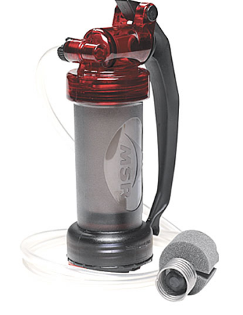
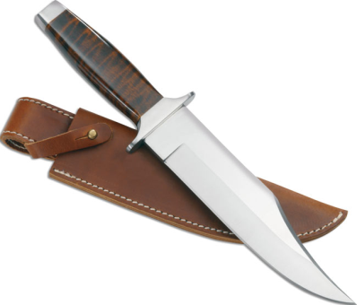
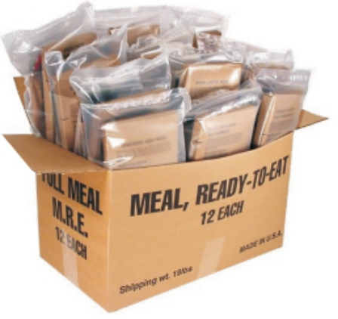
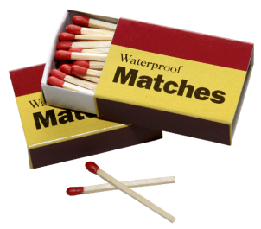
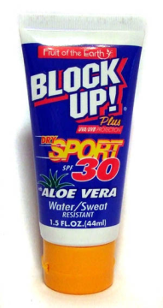
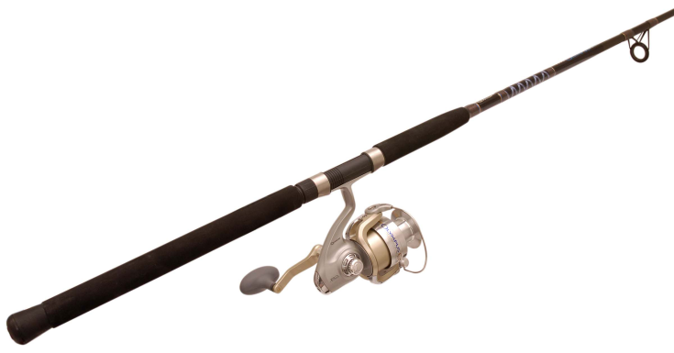
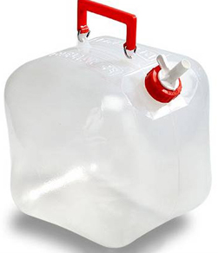
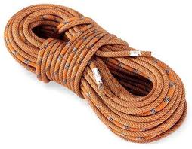
Knife
Emergency
Flares
First Aid Kit
Flashlight
Water Purifier
Waterproof
Matches
Sunscreen
Fishing Pole
Emergency Food
Batteries
Rope
Emergency
Signal Mirror
Two-Way Radio
Water

Slide 14
Reflection
Was it hard to take different roles?
Did you learn more about each other’s ideas?
Did you come to a different conclusion than you would have on your own?
Did everyone contribute?
Were all ideas/suggestions valued?
How did you make your final decisions?

Slide 15
Guiding without Directing
Kids are tricky! They want answers!!
Guidance often will feel like “holding out”
Don’t be afraid of struggle – learning often follows confusion!
Teach kids that being smart means working hard until you figure it out

Slide 16
Content-free Questions
What thoughts do you have about that?
Can you explain to the team what you are thinking in your own words?
Can you give us some details or examples about what you just said?
Can you say more about that?
Any ideas about why that might be the case?
Why do you think that might be true?
Could you restate what you just said?
Adapted from:
Chi, M. T. H., Siler, S. A., Jeong, H., Yamauchi, T., & Hausmann, R. G. (2001). Learning from human tutoring. Cognitive Science, 25(4), 471-533.

Slide 17
Final Activity
Pick one person to be your “coach”
Consult your hand out for content-free prompts to ask your group
Everyone else should be the team
Don’t forget to use good collaboration processes

Slide 18
Epidemiology Problem
Group Z can pass the disease to Group Y and X
Groups V and U can get the disease from Group X
Group Y can infect Group V, and Group V can infect S
Group T can pick up the disease from S, W, and Y
Recently, several people in Group Y caught the rare, but highly infectious disease while traveling to a foreign country. Group Y will spread this disease! What groups of people do not need to worry about catching it?
5 minutes: 1 individual minute, 4 group minutes
Problem Source:
Schwartz, D. L. (1995). The emergence of abstract representations in dyad problem solving. The Journal of the Learning Sciences 4(3): 321-354.
Notes:
No answer key …
My answer: Z, X, U, W

Slide 19
Final Suggestions
Have fun
Stay relaxed
Be patient – learning to be a real team takes time
Keep trying – collaboration is a process

Slide 20
Happy Collaborating!
Any Questions?

